Slide 1
Welcome to the world of
KKT PPT presentation.
Notes:
Welcome slide

Slide 2
Identity of the teacher & the class
Komal Kanta Ray Talukder
Senior Teacher,L.P.High
School & College
Chhatak,Sunamgonj.
Class IX-X
English 2nd Paper
Grammar
Notes:
Identity of the teacher & the class.

Slide 3
May Allah bless you.
Long live my parents.
Notes:
Suspension to lead the lesson

Slide 4
What kind of sentences
have you observed?
Optative Sentence
Notes:
Leading the lesson

Slide 5
Our today’s lesson is-
Optative Sentence
Notes:
Lesson declaration

Slide 6
Learning outcomes
At the end of the lesson, we will be able to—
identify the definition of optative sentence
identify the structures of optative sentence
rearrange the jumble words to make optative sentences
make optative sentence with clue.
Notes:
All the above items will be focused.

Slide 7
What is an optative sentence?
May you live long. May Allah bless you. Wish you all the best. Long live Bangladesh
(can be formed without ‘may’)
The sentence that expresses a desire, prayer
or wish is called an optative sentence.
Notes:
Definition of optative sentence.

Slide 8
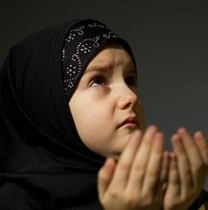
Formation of optative sentence-1
May
+
Subject
+
verb
+
Extension.
May
Allah
allot
us Jannat.
Notes:
Formation with ‘May’

Slide 9
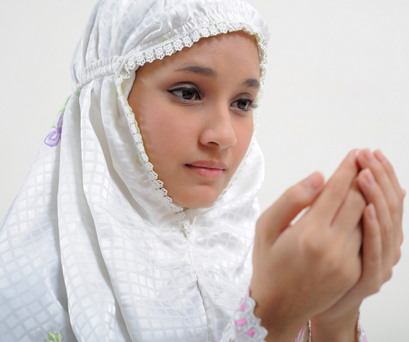
Formation of optative sentence-2
Long
+
verb
+
subject.
Long
live
my mother.
Notes:
Formation with ‘Long’

Slide 10
Formation of optative sentence-3
Wish
+
subject
+
extension.
Wish
all the best.
you
Notes:
Formation with ‘Wish’

Slide 11
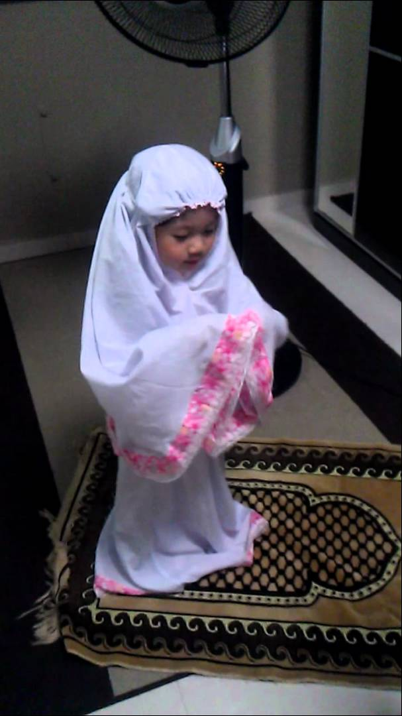
Class activities
Rearrange the sentences into optative
live, country, our, may, long.
upon, you, be, peace.
to, birth, you, to, happy , day.
a, life, happy, wish, you.
Allah, may, me, grace.
Notes:
Evaluation

Slide 12
Write five optative sentences
on the picture.
Notes:
Feed back

Slide 13
Notes:
Ending slide.

